Slide 1
Space Timecard
Eva Czukkermann, Ian Dolfi, Nsadhu Muyinda, Drew Schacke, Luke Schrom, Tanner Smith

Slide 2
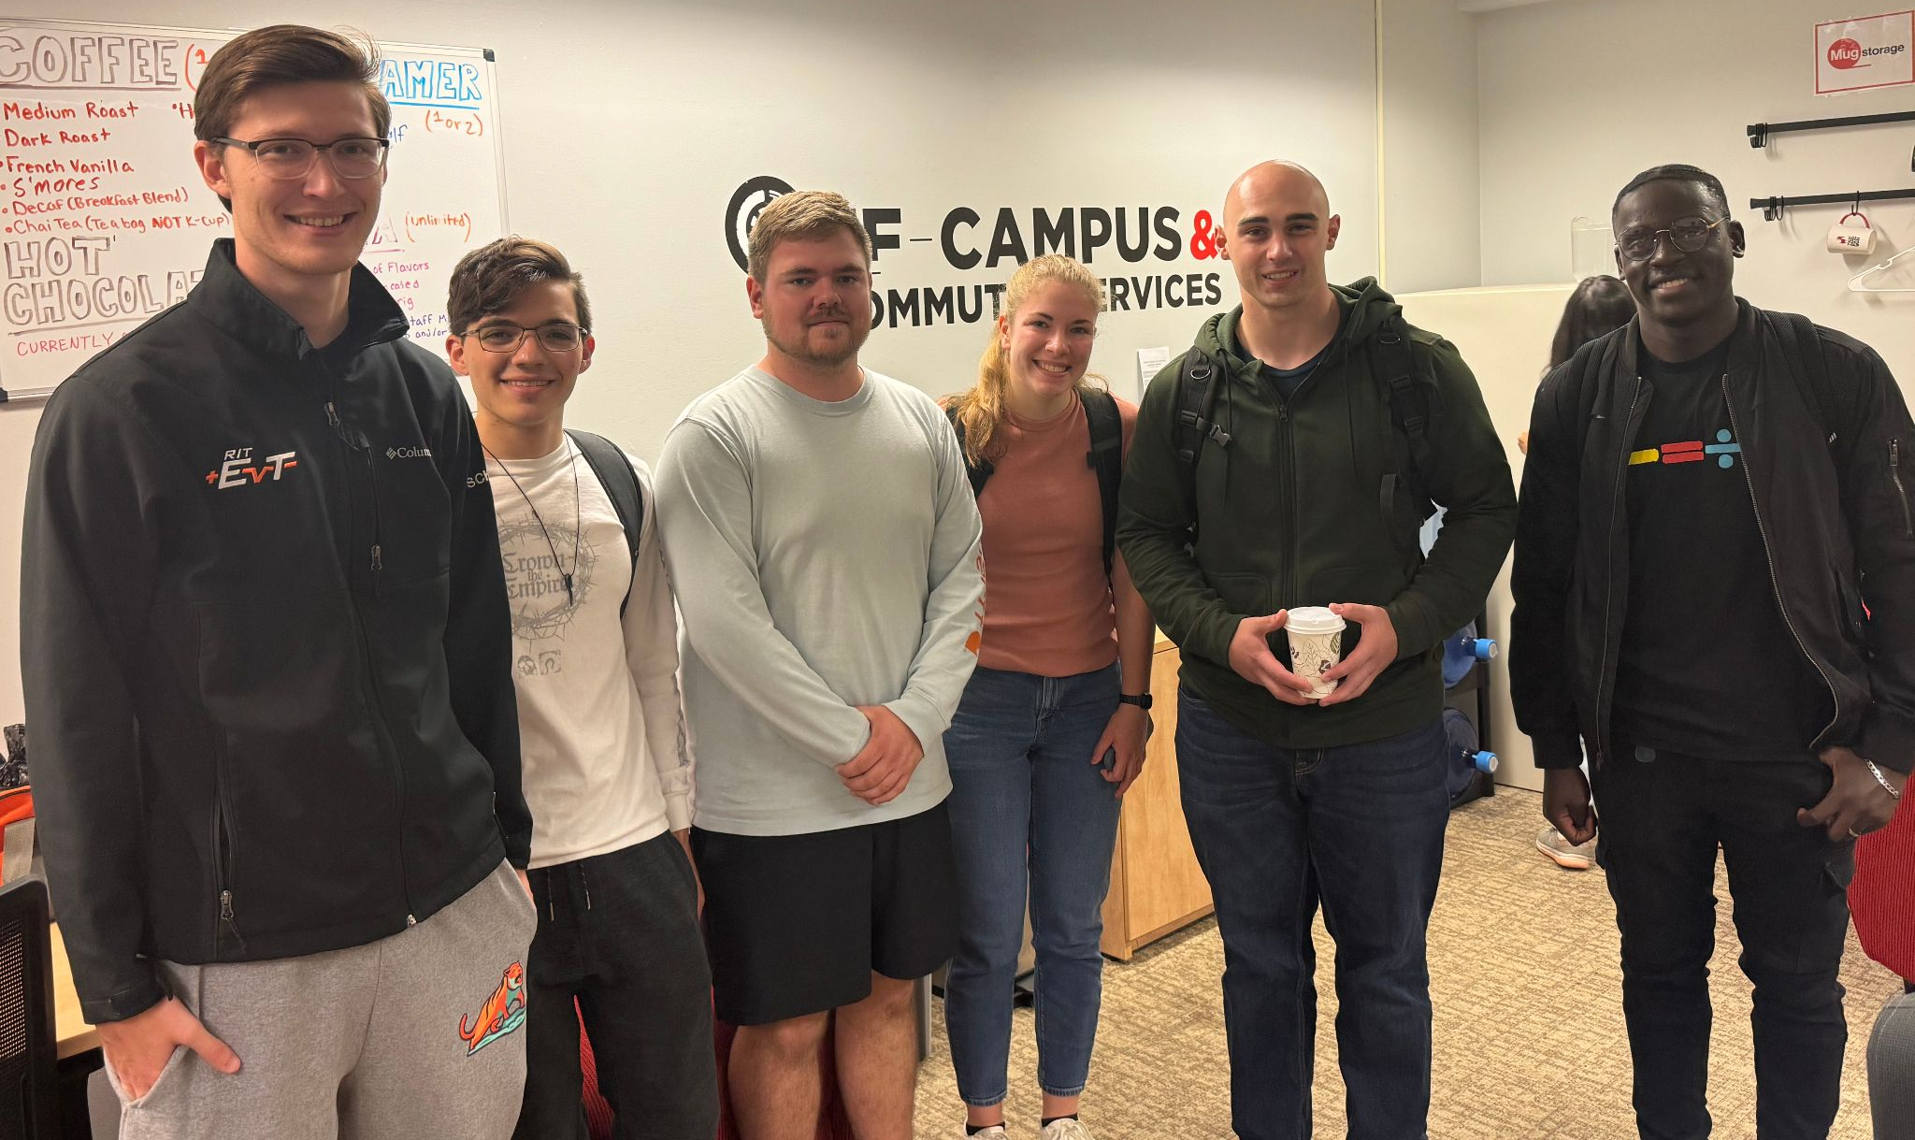
Introduction:
From Left to Right: Luke Schrom, Ian Dolfi, Tanner Smith,
Eva Czukkermann, Drew Schacke, Nsadhu Muyinda

Slide 3
Overview
Team Vision
Methods
Problem Statement
Team Values & Interactions
Use Cases
Customer Requirements
Engineering Requirements
Constraints
House of Quality
Open Items
Goals for Next Phase

Slide 4
Team Vision for Problem Definition Phase
What we accomplished:
Identified basic purposes and use cases for the timecard and future possibilities.
Preemptively researched existing time cards. (Meta, Safran, etc.)
Obtain basic information in order to brainstorm possible restrictions and requirements.
Identified basic engineering requirements and standards.
Recognized risks due to spoofing and jamming.

Slide 5
Methods
The problem was initially defined by the description given by the customers of this project (Philip Linden and Ashley Kosak)
Specifications were benchmarked against two competitor products
Videos and documents provided by the customers were viewed
Additional research was performed on relevant terms and applications
Specific details were discussed with the customers in a video call meeting

Slide 6
Problem Statement
The current ready-to-use space-qualified precision timekeeping devices available cost hundreds to millions of dollars.
The goal of this project is to design and build a derivative Time Card that meets the form-factor and environmental constraints of a CubeSat that is a low-cost alternative. It must have comparable performance under $10k.
The functional prototype must meet drift requirements with statistically significant confidence and it must be an open source design. Additionally, the size, weight, and power characteristics must be compatible with 12U cubesat or smaller and operational characteristics compliant with NASA LunaNet Standard. The timekeeping drift must be less than 30 nanoseconds per Earth day. The atomic clock must survive deep space conditions for at least 10 years and be widely interoperable with existing spacecraft systems.
Source: EduSource Information

Slide 7
Team Values and Interactions
5 Team Values
Timely communication
Honest feedback
Relatively equal contribution
100% effort on all tasks
Open minded
Conflict Strategy: list pros and cons of situation, discuss them, and come to a final solution
Hold Teammates Accountable: Provide honest feedback about the lack of effort
Forms of Communication: Text and Slack

Slide 8
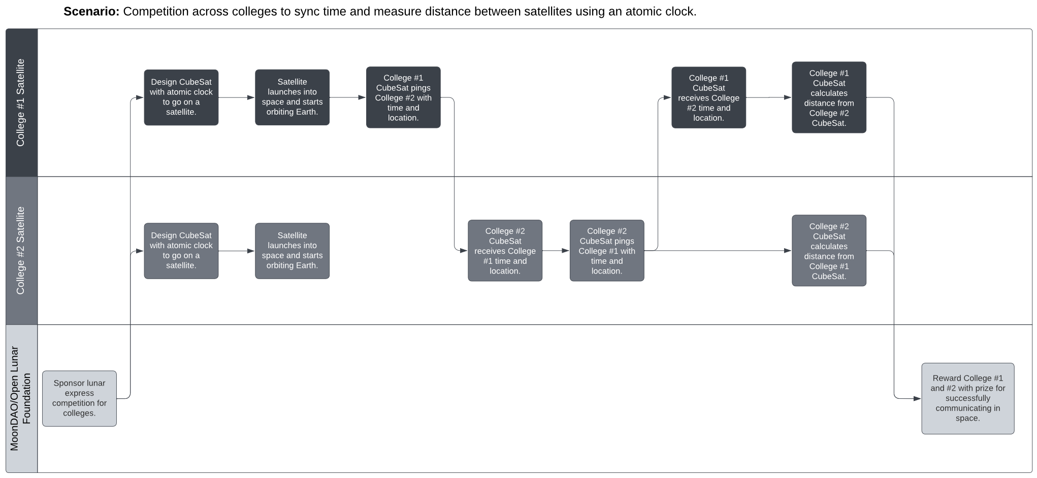
Use Cases
Competition across colleges to sync time and measure distance between satellites using an atomic clock.

Slide 9
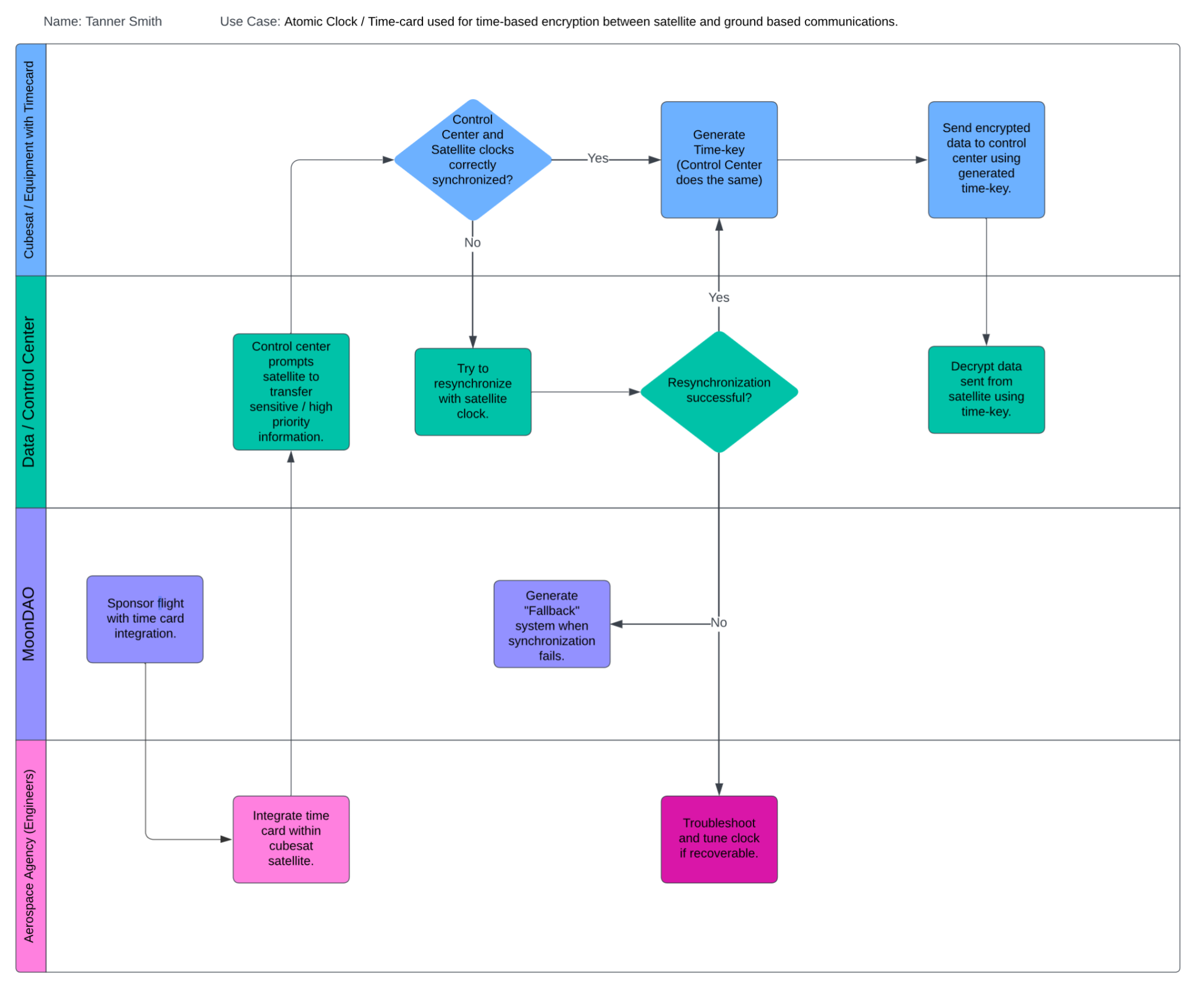

Slide 10
Customer Requirements
We are tracking toward completing the following key CRs. Official MSD CR format is located on the next slide.
Design and build a functional derivative Time Card containing FPGA (and other processes) as well as other board components.
Compatible with CubeSats and its standards
Operational characteristics are compliant with NASA LunaNet Standard
All components rated to survive deep space conditions (GEO and beyond) for at least 10 years
Widely interoperable with existing spacecraft systems
Minimize size, weight, and power characteristics
Maintains accuracy over time
Communicates with other time networks

Slide 11
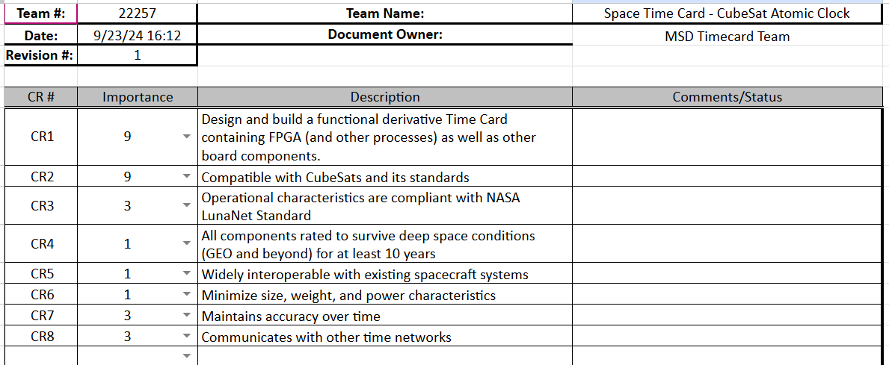
Customer Requirements - Official MSD Format

Slide 12
Engineering Requirements (Metrics & Specifications)
Maximum 20cm X 20cm X 30cm
Maximum 50 kilograms
Max payload average power 40W
Timekeeping drift maximum 30 nanoseconds per Earth day
1 Nanosecond clock speed
PCIe Interfacing
1 Ghz ≤ FPGA processor
NASA standard compliant
FPGA to manage time keeping
GNSS to communicate with satellites
Driver for timecard

Slide 13
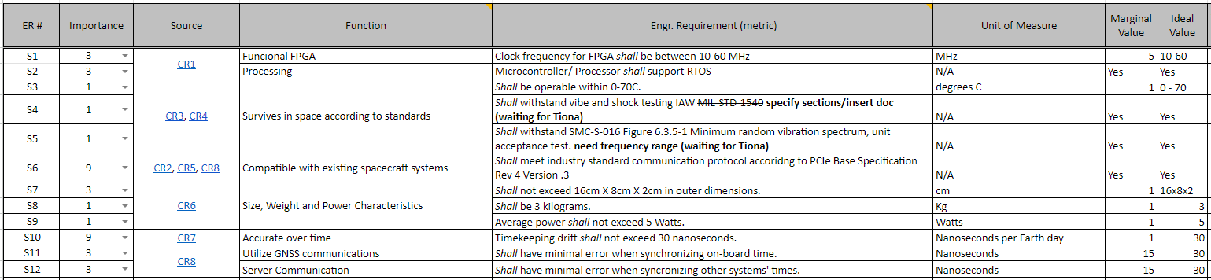
Engineering Requirements - Official MSD Format

Slide 14
Constraints
Size, weight, and power characteristics are compatible with 12U CubeSat or smaller
Timekeeping drift less than 30 nanoseconds per earth day
Include an FPGA for custom programmable logic synthesis
Integrated Atomic Clock for timekeeping
Completely Open-Source
Maximum budget constrained to $10k, preference placed on under $5k

Slide 15
Risks
Radiation resistance
Temperature Extremes
Vacuum Conditions
Electromagnetic Interference
Material Outgassing
Electrostatic Discharge
Connector and Solder Reliability
Redundancy
Fault Tolerance
Communication Interference
Software and Firmware Reliability

Slide 16
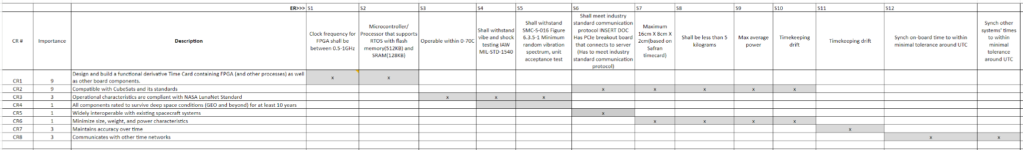
House of Quality

Slide 17
House of Quality
All engineering requirements are traceable to customer requirements.
All customer requirements are addressed by either an engineering requirement or constraint.
This ensures that all constraints and engineering requirements are necessary.
From the ER-CR mapping, it can be concluded that the team has captured the essential needs of the customer.

Slide 18
Open Items
Deep space durability needs to be further understood with respect to the project and what it entails.
More research can be done to understand alternative devices and how this goal was achieved
This can be done during the start of Phase 2.
If a SOC can be used instead of an FPGA and microcontroller
The advantages and disadvantages of each can be weighed to determine which is the better option.

Slide 19
Goals for Next Phase
Identify Possible FPGAs, Microcontrollers, CSACs, OCXOs, TCXOs.
Possible removal for the need of CSAC?
Understanding of GNSS receivers and interfacing with previously mentioned atomic clock (Hardware vs software solutions).
Verify functionality and environmental testing of prototype parts.
Explore other open source projects. Obtain as a team fundamental operation and basic layout of the card.
Identify possible hardware and software improvements and implementations (cost, speed, environmental resistance).
Formal list of planned tasks (per team member) and overall project plan will be updated upon completion.

